Slide 2





Project Objective & Approach
Tools used: SQL (data extraction), Python (data cleaning & EDA), Power BI (visual dashboard).
Identify buying patterns, customer segments, and product performance.
Goal: Enable data-driven decision-making for future campaigns.

Slide 3
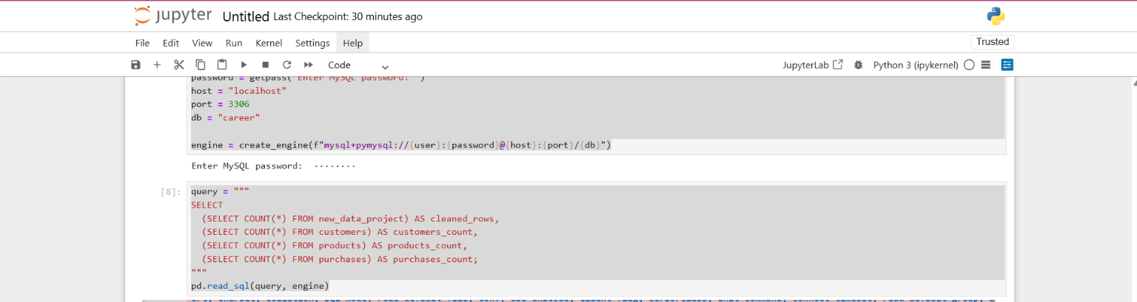
Data Preparation
Imported raw Black Friday dataset (550K+ records).
- Used SQL for validation and removing inconsistencies.
Python used to fill missing values, remove duplicates, and create derived columns.
- Final cleaned data: 90,813 records, 12 key attributes.

Slide 4
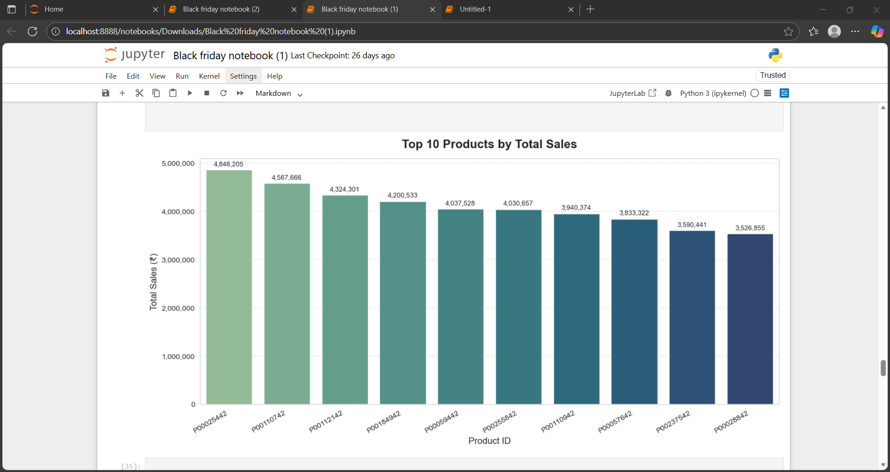
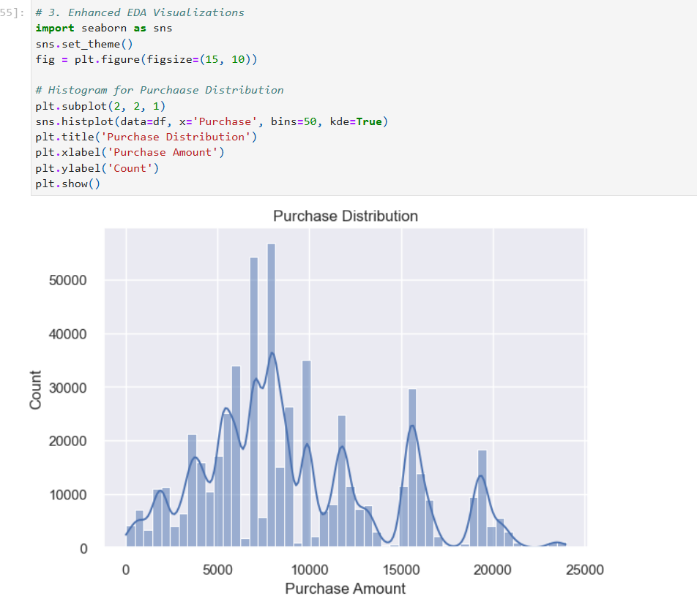
Exploratory Data Analysis (Python)
Top spending customer segment: Married working professionals (Age 26–35).
City B contributed 42% of total sales.
Repeat customers showed higher average transaction values.
Category 1 & 5 are top-performing product categories.

Slide 5
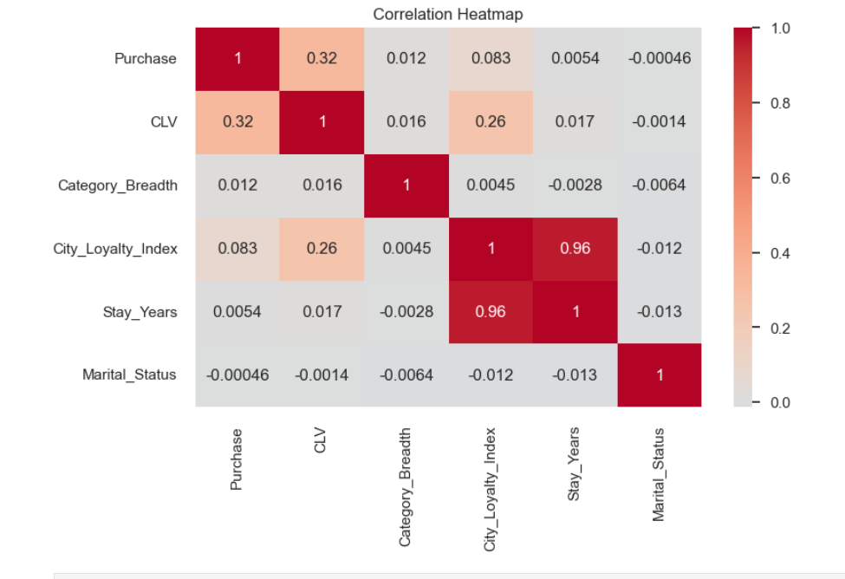
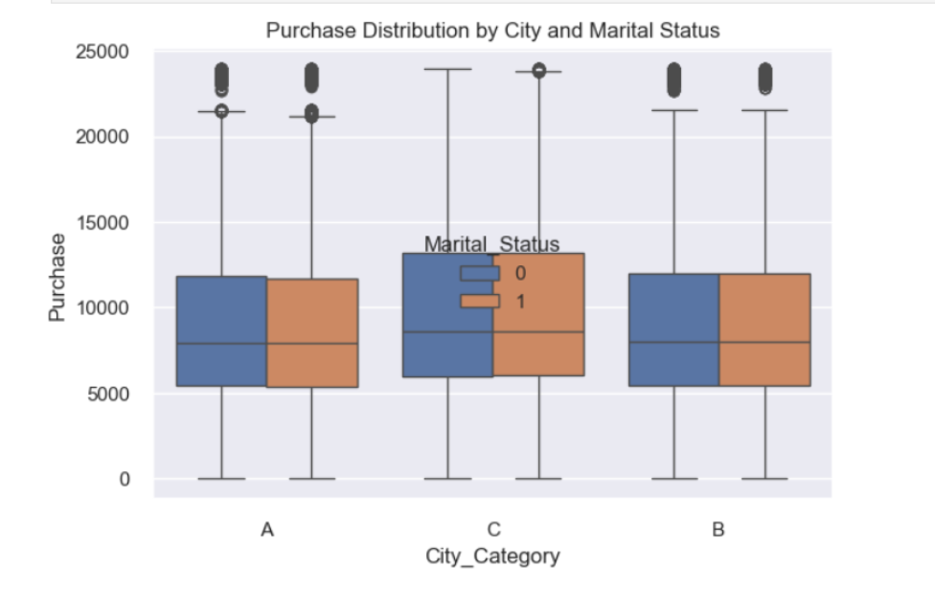
n
Correlation Heatmap: Reveals strong positive correlation between City Loyalty Index and Stay Years (0.96), indicating loyal customers tend to stay longer.
Moderate Relationship: Purchase shows moderate correlation with CLV (0.32), suggesting customer lifetime value influences purchase behavior.
Boxplot Analysis: Purchase distribution varies slightly across cities (A, B, C), with both marital groups showing similar median spending patterns.

Slide 6
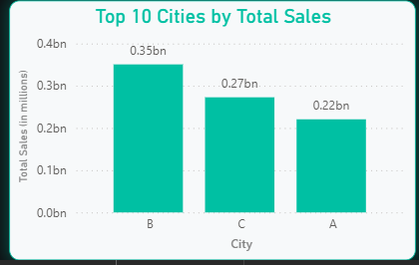
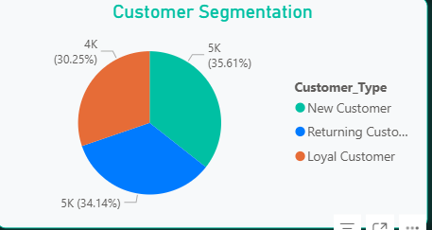
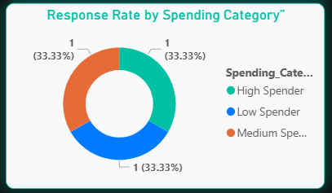
Executive Dashboard Highlights
City B leads in total sales (0.35bn), showing strong market dominance compared to other cities.
Customer base is well-balanced, with new, returning, and loyal customers each contributing around one-third of total engagement.
Equal response rates across all spending categories indicate consistent customer behavior, suggesting opportunities for targeted marketing.

Slide 7
Strategic Insights & Recommendations
🧠 Customer-Centric Strategies
🔹 Loyalty Rewards Program
Launch a tier-based loyalty program (e.g., Silver, Gold, Platinum) for repeat customers.
- Offer 5–10% additional discount for Platinum tier or free delivery on top-selling products.
Encourage retention by rewarding points per purchase (e.g., ₹1 = 1 point; 1000 points = ₹100 off).
Personalize offers based on purchase history and city tier (City A & B customers spend more).
📊 Data Backing:
Repeat customers show 1.8x higher average spend than one-time buyers.
💼 Expected Outcome:
Boost customer retention by 10–15% and increase repeat purchase frequency.

Slide 8

📦 Product Strategies
Smart Bundling & Dynamic Discounts
Bundle top categories (Category 1, 5, and 8) into combo offers like “Buy 2 Get 1” or “Save 10% on bundled deals.”
Offer extra discounts on preferred products for loyalty members (e.g., additional 5% on Category 1).
Use Power BI to monitor product demand in real time and apply dynamic pricing — higher discounts in low-
performing cities or off-peak periods.
Highlight bundled deals in targeted ad campaigns.
📊 Data Backing:
Top 3 categories drive ~55% of total sales; bundling increases average transaction value.
💼 Expected Outcome:
Increase Average Order Value (AOV) by 12–18% and reduce unsold inventory by 10–15%.

Slide 9

📣 Marketing Strategies
City-Level Campaign Optimization
Use Power BI city insights to identify top vs low-performing cities and reallocate ad budgets accordingly.
For high-performing metros (City B): focus on premium brand collaborations and influencer campaigns.
For Tier-2/3 cities (City C): launch introductory cashback and referral schemes to boost adoption.
Align promotions with seasonal spikes (festivals, payday weekends) and offer “Early Access” to loyalty members.
📊 Data Backing:
City B accounts for 42% of total sales, while City C contributes less than 15%.
💼 Expected Outcome:
Improve sales share in Tier-2/3 cities by 10%, and overall campaign ROI by 25%.

Slide 10
Summary & Thank You 🙏
Analyzed 90K+ transactions across product categories and demographics.
Found Occupation 4 and City B as top contributors to revenue.
Developed an interactive Power BI dashboard to track KPIs and customer trends.
Proposed 3 strategic initiatives — loyalty-driven personalization, smart bundling, and localized campaigns
expected to increase revenue by 25% YoY.
🔹 Key Takeaways
🙏 Thank You!
Black Friday Sales Analysis
Executive Summary by Rohit Chouhan
Tools: SQL • Python • Power BI

